Slide 1
Protecting Yourself
How to be Cyber-Safe at home

Slide 2
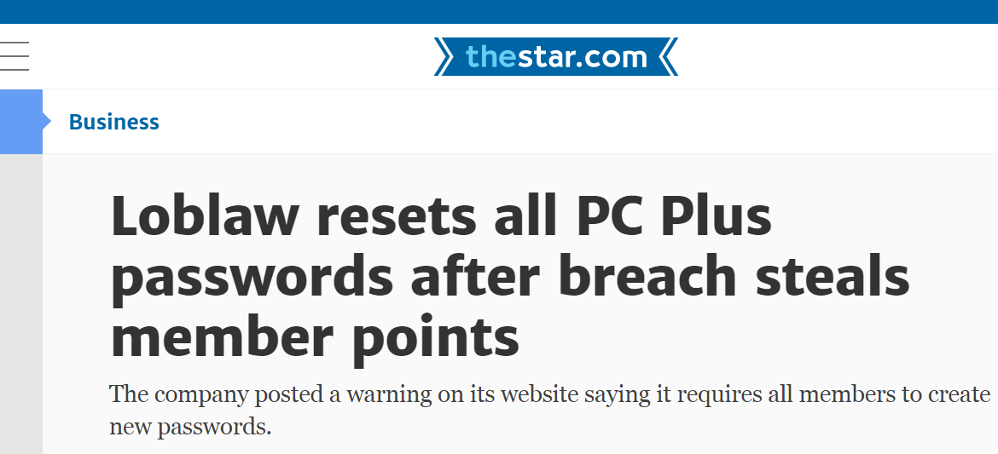
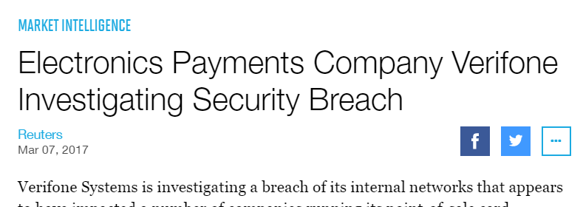
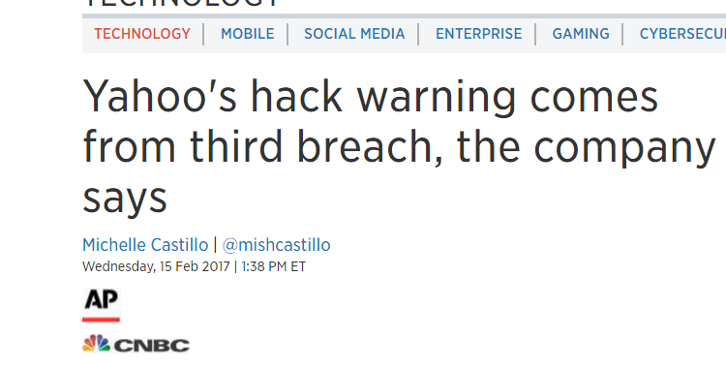
OMG you’ve been breached!

Slide 3
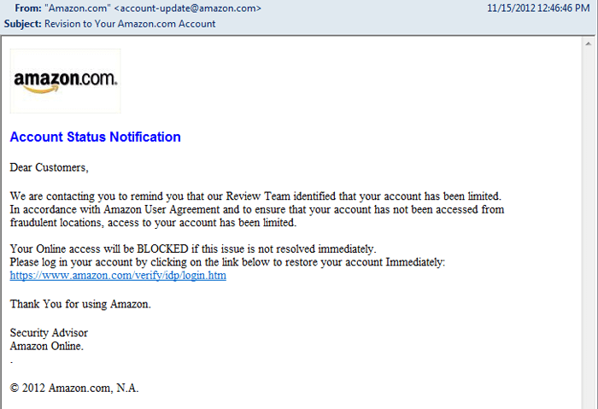
Methods of Entry - Phishing

Slide 4
What can I do? - Phishing
Be vigilant against unsolicited email – email that was not initiated by you
Check the sender
Look for misspellings and/or bad grammar – translation
Check the link – hover over, does it match?
Look for similar characters – I,l,1, O,0, m, rn
Sense of urgency – Open now, don’t let this expire
Attachments – Asks you to enable macros
Asks for credentials/password – Click to change password
Emotion/Relevant news – Donation to support recent catastrophe
CALL THE COMPANY DIRECTLY!

Slide 5
Methods of Entry - Malvertising

Slide 6
What can I do? - Phishing
Keep systems up-to-date – Windows/Mac/iPhone/Android
Keep applications up-to-date – Adobe Reader/Microsoft Office
Remove/disable ‘unnecessary applications’ – Adobe Flash/Java/Silverlight
Use a service to help – OpenDNS
http://www.opendns.com
Use a secondary utility to help scan - Immunet
http://www.immunet.com
Install an anti-ransome utility – RansomFree
https://ransomfree.cybereason.com/

Slide 7
Methods of Entry – Hacking (Insecure devices)

Slide 8
What can I do? - Phishing
Change default logins and passwords
Upgrade firmware – This is the software that runs devices
Do not directly connect devices to the internet – put them behind your router
Do not connect devices that shouldn’t be connected

Slide 9
Phone: 519-792-9783
Email: Rob@rccms.ca
Web: www.rccms.ca
Twitter: rc_cms

